Slide 1
FIT3152 Data analytics 2024: Assignment 2
31994695 June Jin
Notes:
Hello my name is june, I m going to explain about my data analytics assignment 2.

Slide 2
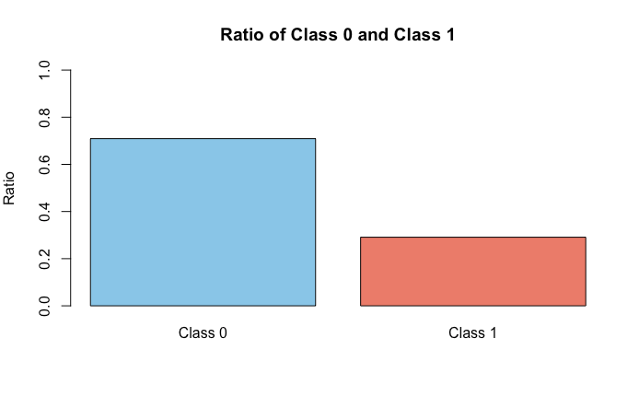
Proportion of phishing site
Legitmate site , (0): 1418
Phishing site , (1): 582
Proportion of phishing site to letimate site : 582/2000
Notes:
First, I m going to talk about the proportion of phishing sites to legitimate sites.
There were a total of 2000 rows and 26 columns in the dataset. Among the 2000 sites, 582 were phishing sites and 1418 were legitimate sites.
Therefore, the proportion of phishing sites is 582/2000, which corresponds to 29.1% of the total.

Slide 3
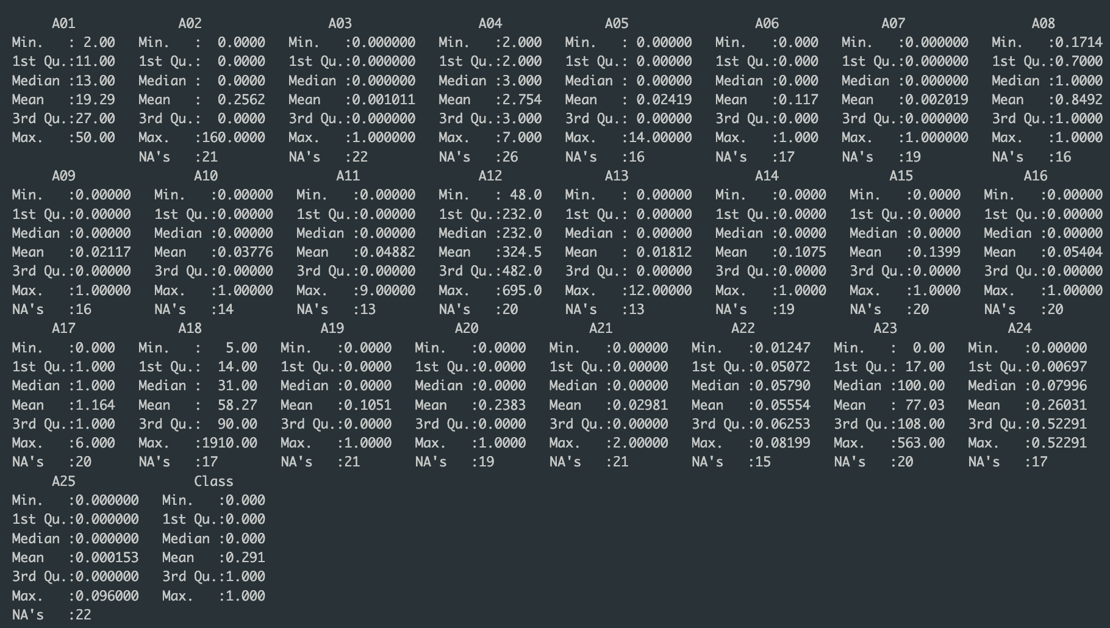
Summary of data
Notes:
I could see the mean, and median values of each attributes from the data. However, I couldn’t notice about the anything noteworthy in the data. I concluded that it will be available to find noteworthy data only after implementing classifier.

Slide 4
Preprocessing of data
Removing all the NA values from the data
Before removing the NA values : 2000 rows, 26 columns
After removing the NA values : 1605 rows, 26 columns
As.factor() function used to class column to make factor variables
Notes:
There are 2 things that I did in the pre processing of this data.
First, I removed all the NA values from the data.
The original data dimensions was 2000 rows and 26 columns
It became 1605 rows and 26 columns after removing the NA values row.
After that, I made class attributes as a factor

Slide 5
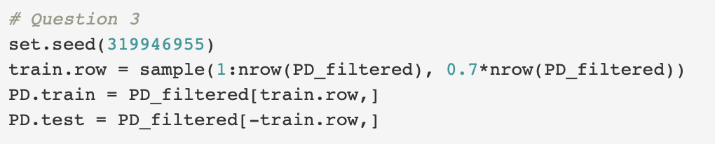
Dividing the data
Notes:
I divided my data into a 70% training and 30% test set by adapting the following code. The code is from Assignment instruction, with my student ID seeds.

Slide 6
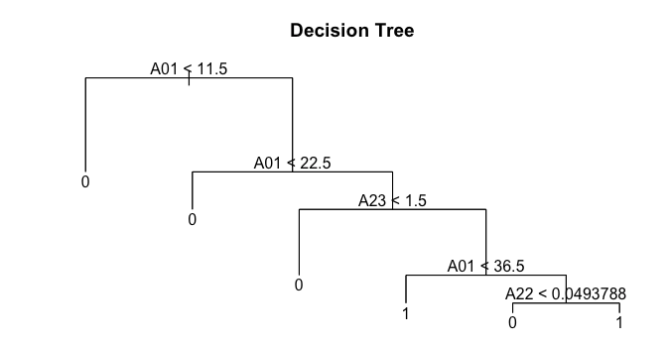
Performance and Accuracy Decision tree
Decision Tree
6 Terminal nodes
Notes:
Now I m going to talk about the performance and accuracy of each model.
For Decision tree, 6 terminals were founded.

Slide 7
Performance and Accuracy other classificaion models
Naïve Bayes: naiveBayes() function
Bagging: bagging() function
Boosting: boosting() function
Random Forest: randomForest() function
Data used to train the model : PD.train
Notes:
We used the PD.train data for train the model.

Slide 8
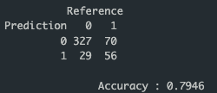
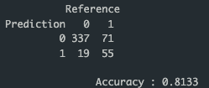
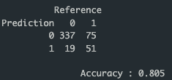
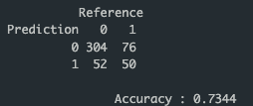
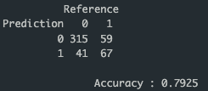
Confusion matrix
Decision Tree
Bagging
Random Forest
Naïve Bayes
Boosting
Phishing (1)
Legitimate (0)
Notes:
This is the confusion matrix of each classifier and accuracy too.

Slide 9
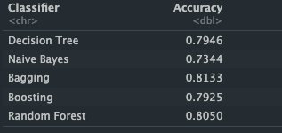
Summary of classification models
Overall high Accuracy all
Bagging model has the best accuracy
Naïve Bayes model performs worse
Notes:
Overall, all the accuracy of 5 classifiers were quigh high.
Bagging model has the best accuracy, Naïve Bayes model performs worse, which is 0.73

Slide 10
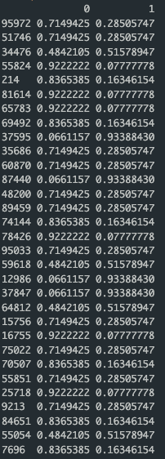
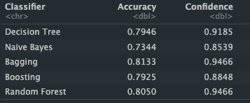
Confidence of predicting ‘phishing’
Decision Tree -
All classifier has same dimenstion of this confidence
Sensitivity
Notes:
Now I m going to talk about the confidence of predicting “phishing website”.
As you can see, there are the 2 columns for each classifier. I put one image for confidence from the decision tree, but all the dimension are same with this dimension.
These number means the confidence of probability each of classifiation model.
And, I put sensitibity value as confidence in the table.

Slide 11
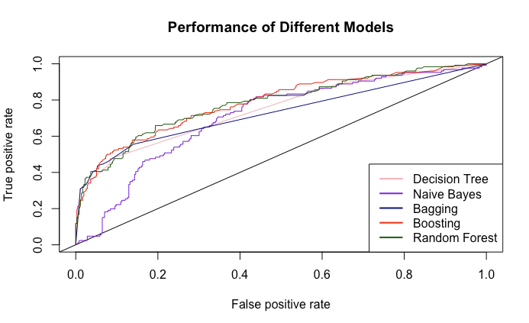
Roc curve for each of classifier
AUC values – overall performance of binary classification model to separate positive and negative classes
Notes:
ROC curved ploted each of classifier.
AUC values means that the overall performance of binary classification model to differentiate positive and negative classes.

Slide 12
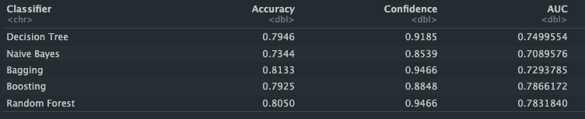
AUC table with overall data
Bagging performs the best in terms of accuracy
Boosting performs the best overall in terms of AUC value

Slide 13
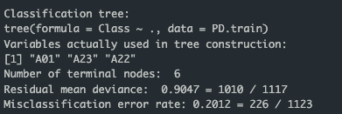
Most important variables in predicting whether a website will be phishing or legitimate
Decision Tree
A01, A23, A22

Slide 14
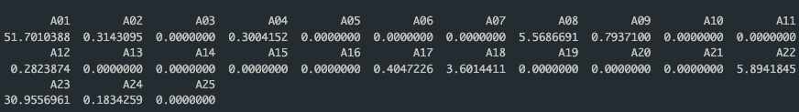
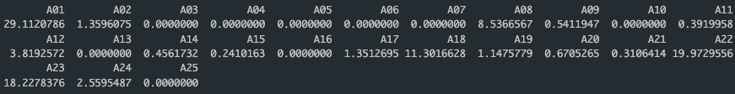
Bagging
Boosting

Slide 15
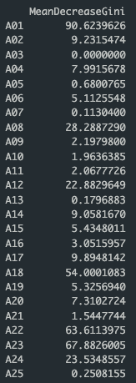
Random Forest

Slide 16
Most important variables in predicting whether website will be phishing or legitimate
The higher number for each of the variables, the higher importance of the variables used in the classification model.
A01, A22, A23, A18 are very consistently appear as important variables with high importance score.
A lot of attributes have low importance which is zero.

Slide 17

Classifier that is simple enough for a person to be able to classify whether a site is phishing or letimate by hand
Attributes chosen : A01, A18, A22, A23, A26

Slide 18
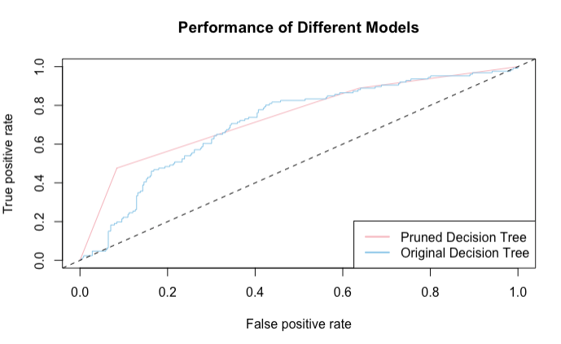
Best tree based classifier Decision tree
Cross validation of decision tree, with post pruning
Accuracy : 0.8008299
AUC value : 0.7499 > 0.7405, didn’t improved
Notes:
The Accuracy has slightly improved to 0.8
However, AUC value didn’t improved with 0.74 compare to normal decision tree, 0.7499

Slide 19
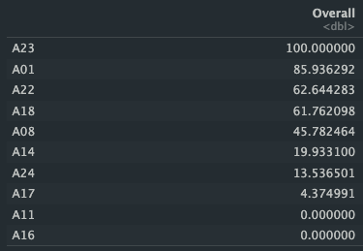
Best Tree classifier - Bagging
Bagging model with gridsearch
Selected A01, A18, A22, A23, A26 attributes based on the Importance.
Accuracy of 0.8154 – higher than 0.8133 (normal bagging – question 4 ~ )
Notes:
This is the improved bagging model.
I used gridsearch for finding the best attributes, and I could get 5 attributes were overall high score.
Therefore, I used that attributess for new bagging model, and the accuracy of new bagging model was slightly higher than normal bagging model.

Slide 20
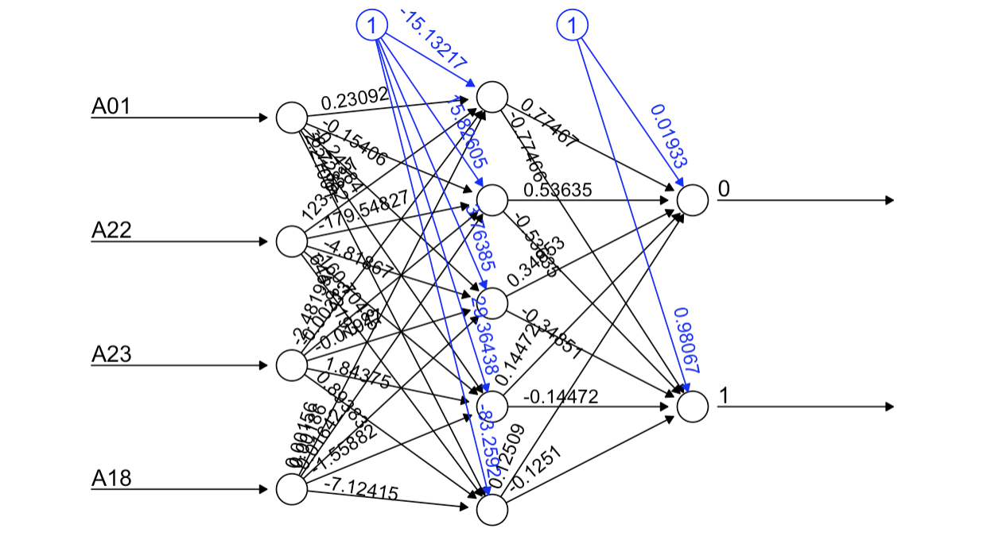
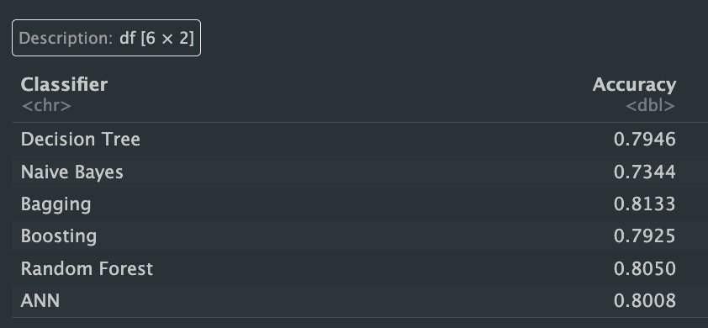
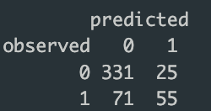
Artificial Neural Network
Attributes used A01, A22, A23, A18
Notes:
The predictor ariables were didn’t normalized based on the edstem.
The missing valuesa are omitted at first.
And here is the plot of artificial newral network.
We could get the accuracy which is 0.8008, as you can see, the bagging accuracy is still the highest compare to the other classifier’s accuracy.

Slide 21
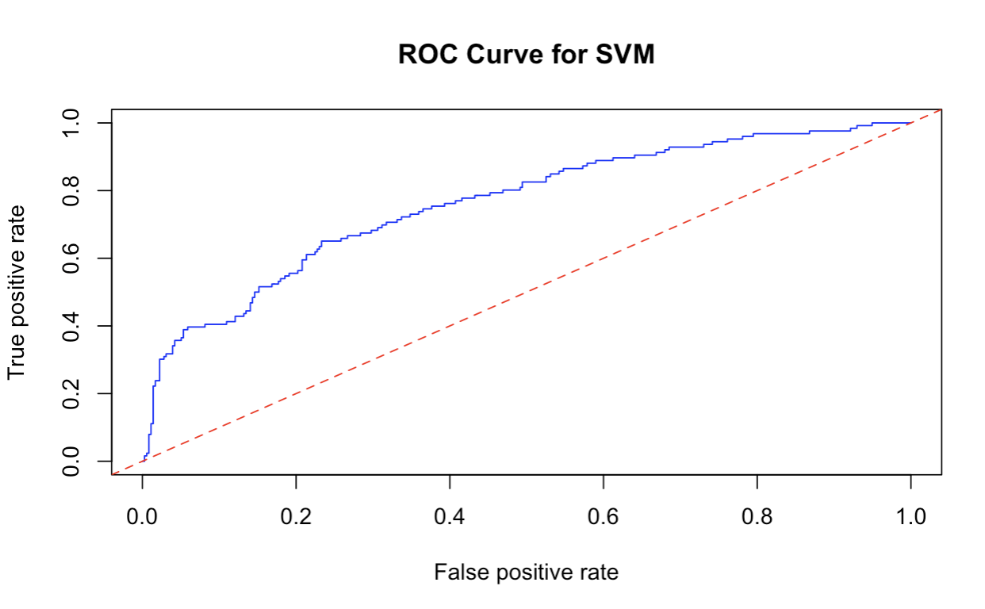
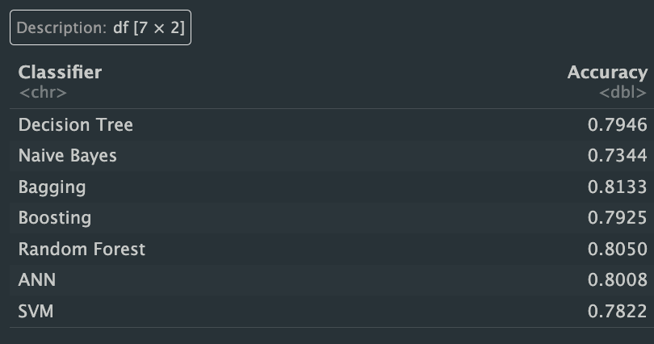
NEW classifier : Support vector machine - SVM
SVM helps find optimal decision boundaries, regression functions, and data anomalies.
Accuracy : 0. 7822
AUC value : 0.762
Notes:
Now I also implemented new classifer which is support vector machine.
So, The accuracy was 0.78 which is lower than Artificial Neural Network classifier’s accuracy.
And, The Auc value was 0.762.
Therefore, we could see that the bagging model’s accuracy was remained still the highest compare to the others.

Slide 22
Conclusion
Various methods that can be implemented to predict of the phishing website based on the datasets.
We can choose the best classificiation method with using tuning parameters.

